Slide 1

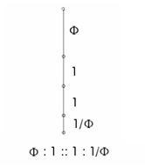
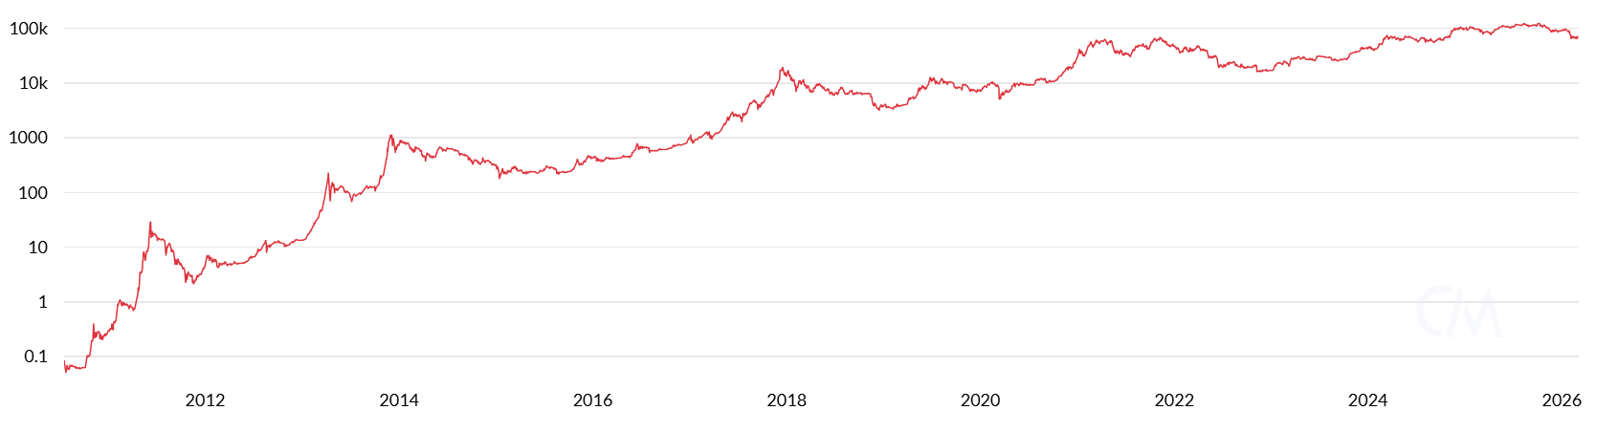
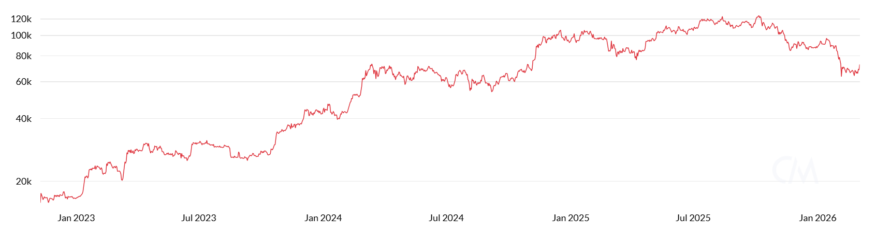
Days | Segment | Start Date | End Date
531.3 | Phi | 11/10/2022 | 4/24/2024
328.4 | 1 | 4/24/2024 | 3/18/2025
328.4 | 1 | 3/18/2025 | 2/10/2026
202.9 | 1/Phi | 2/10/2026 | 9/1/2026
The Connection Between Crop Circles and Bitcoin
1
1
Φ
1/Φ

Slide 2
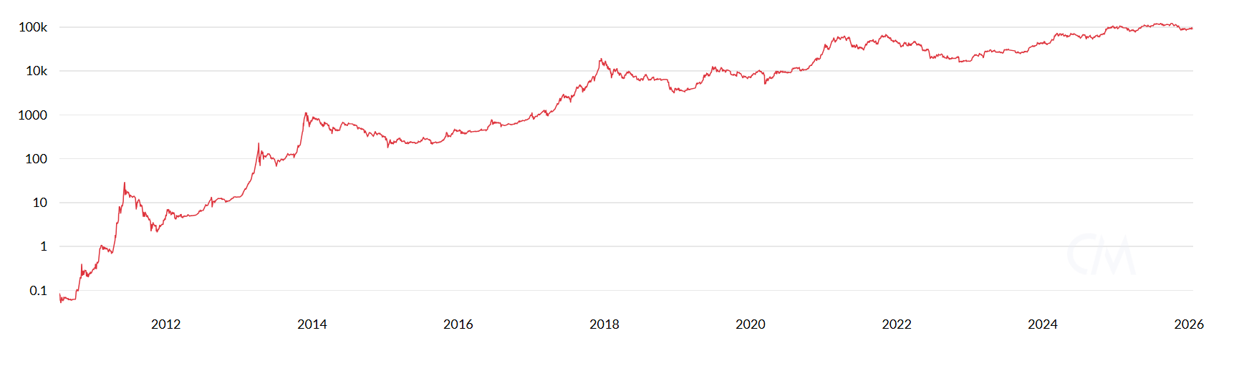
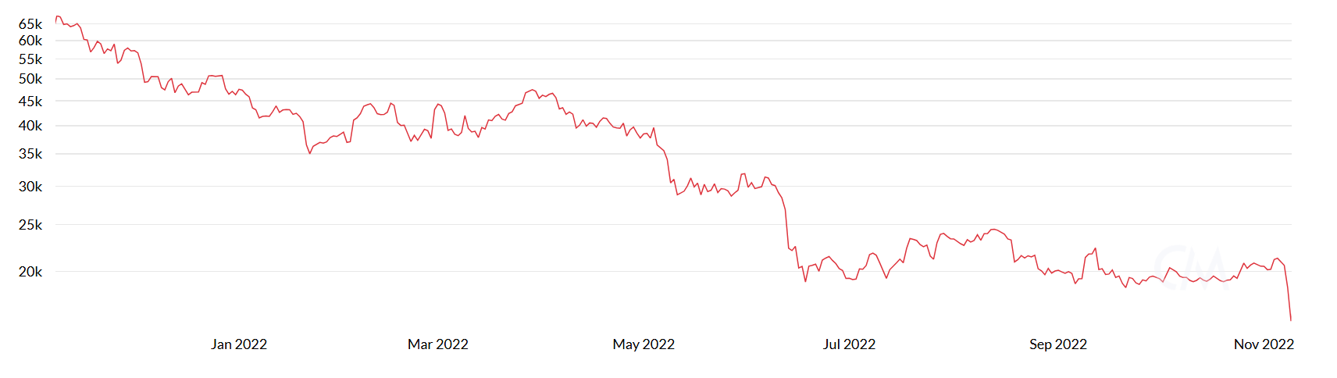
Days | Segment | Start Date | End Date
139.4 | Φ | 11/9/2021 | 3/28/2022
86.2 | 1 | 3/28/2022 | 6/22/2022
86.2 | 1 | 6/22/2022 | 9/16/2022
53.3 | 1/Φ | 9/16/2022 | 11/9/2022
The Connection Between Crop Circles and Bitcoin
Φ
1
1
1/Φ

Slide 3
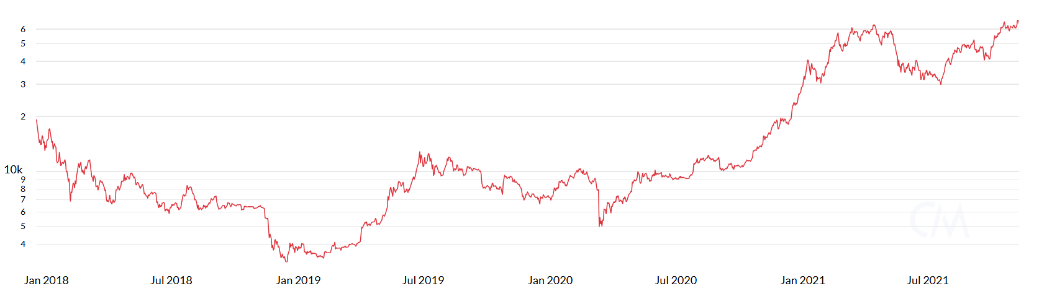
Days | Segment | Start Date | End Date
543.2 | Φ | 12/17/2017 | 6/13/2019
335.7 | 1 | 6/13/2019 | 5/13/2020
335.7 | 1 | 5/13/2020 | 4/14/2021
207.5 | 1/Φ | 4/14/2021 | 11/8/2021
The Connection Between Crop Circles and Bitcoin
1/Φ
1
1
Φ

Slide 4
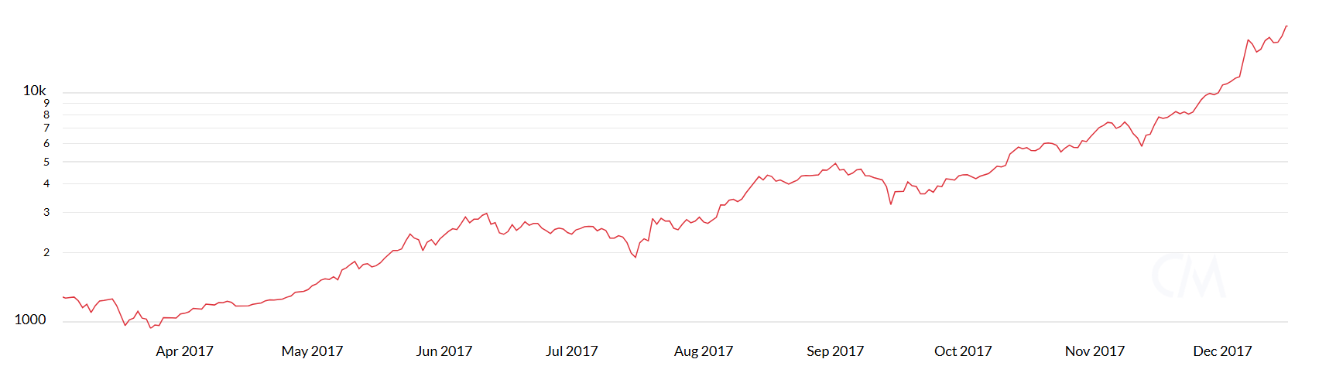
Days | Segment | Start Date | End Date
109.6 | Φ | 3/4/2017 | 6/21/2017
67.8 | 1 | 6/21/2017 | 8/28/2017
67.8 | 1 | 8/28/2017 | 11/4/2017
41.9 | 1/Φ | 11/4/2017 | 12/16/2017
The Connection Between Crop Circles and Bitcoin
1/Φ
1
1
Φ

Slide 5
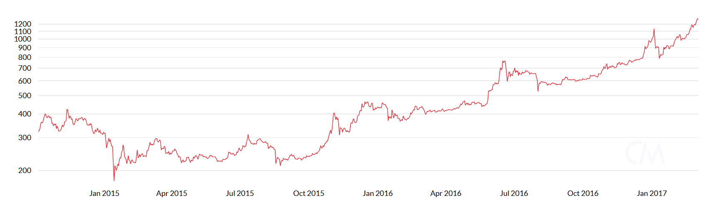
Days | Segment | Start Date | End Date
335.7 | Φ | 10/6/2014 | 9/6/2015
207.5 | 1 | 9/6/2015 | 4/1/2016
207.5 | 1 | 4/1/2016 | 10/25/2016
128.2 | 1/Φ | 10/25/2016 | 3/3/2017
The Connection Between Crop Circles and Bitcoin
1/Φ
1
1
Φ

Slide 6
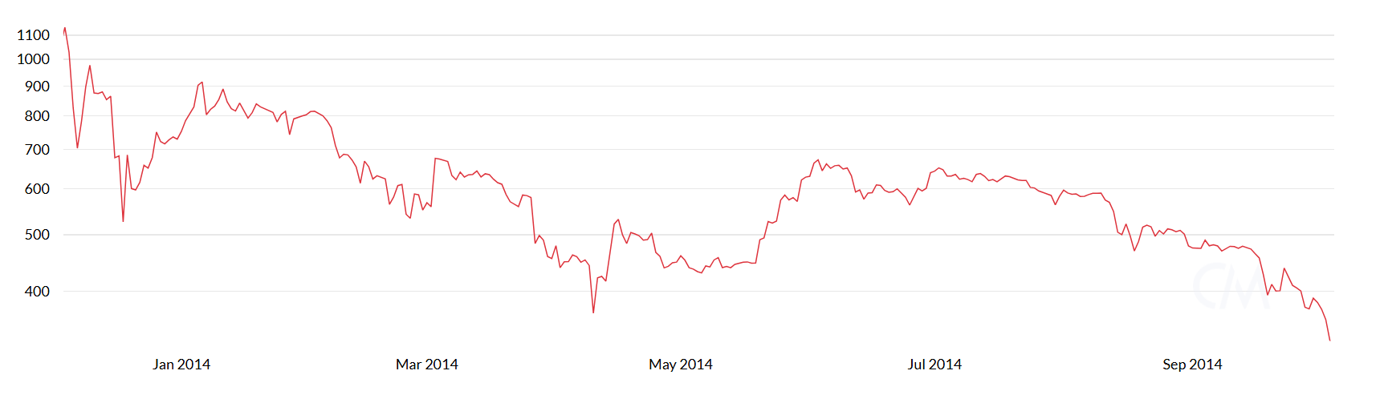
Days | Segment | Start Date | End Date
116.1 | Φ | 12/5/2013 | 3/31/2014
71.8 | 1 | 3/31/2014 | 6/10/2014
71.8 | 1 | 6/10/2014 | 8/21/2014
44.4 | 1/Φ | 8/21/2014 | 10/5/2014
The Connection Between Crop Circles and Bitcoin
1
1
1/Φ
Φ

Slide 7
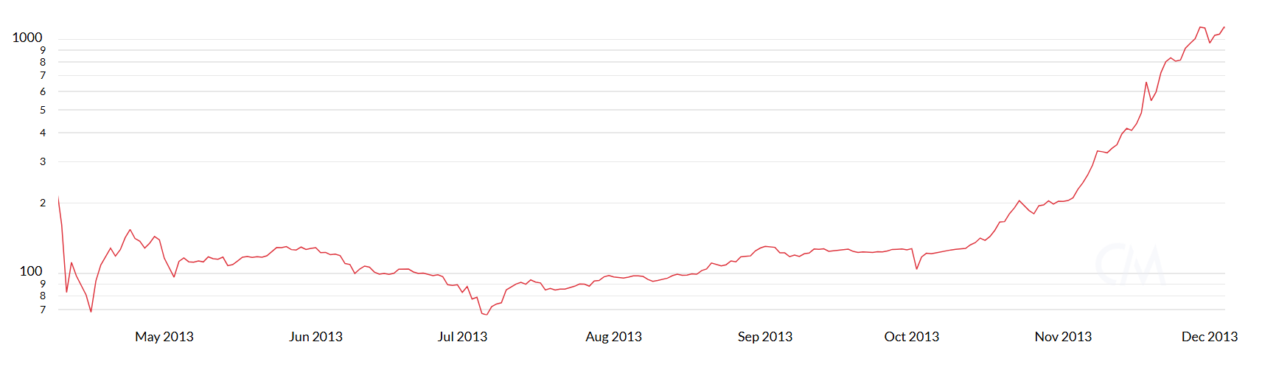
Days | Segment | Start Date | End Date
90.9 | Φ | 4/10/2013 | 7/9/2013
56.2 | 1 | 7/9/2013 | 9/4/2013
56.2 | 1 | 9/4/2013 | 10/30/2013
34.7 | 1/Φ | 10/30/2013 | 12/4/2013
The Connection Between Crop Circles and Bitcoin
1/Φ
1
Φ
1

Slide 8
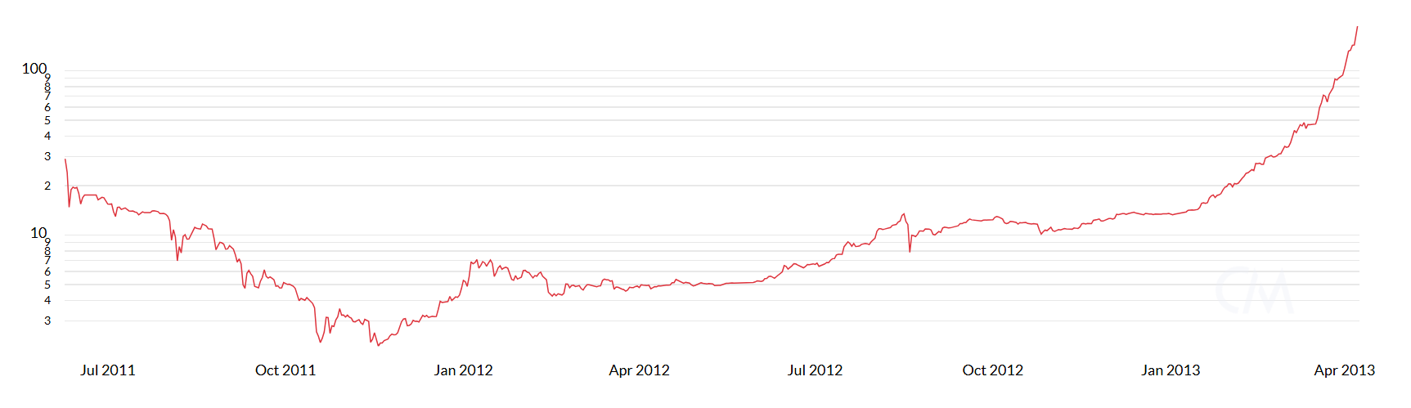
Days | Segment | Start Date | End Date
255.9 | Φ | 6/9/2011 | 2/19/2012
158.2 | 1 | 2/19/2012 | 7/27/2012
158.2 | 1 | 7/27/2012 | 1/1/2013
97.8 | 1/Φ | 1/1/2013 | 4/9/2013
The Connection Between Crop Circles and Bitcoin
1/Φ
1
Φ
1

Slide 9
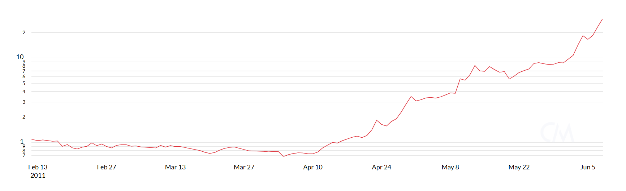
Days | Segment | Start Date | End Date
43.9 | Φ | 2/13/2011 | 3/28/2011
27.1 | 1 | 3/28/2011 | 4/25/2011
27.1 | 1 | 4/25/2011 | 5/22/2011
16.8 | 1/Φ | 5/22/2011 | 6/8/2011
The Connection Between Crop Circles and Bitcoin
1/Φ
1
Φ
1

Slide 10
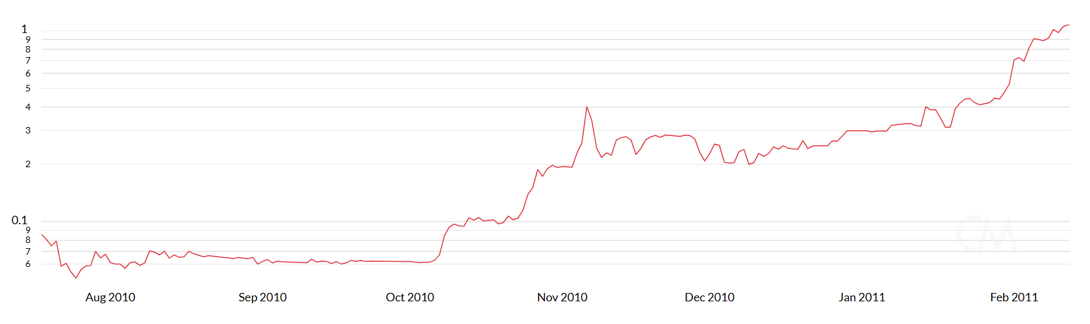
Days | Segment | Start Date | End Date
79.8 | Φ | 7/18/2010 | 10/5/2010
49.3 | 1 | 10/5/2010 | 11/24/2010
49.3 | 1 | 11/24/2010 | 1/12/2011
30.5 | 1/Φ | 1/12/2011 | 2/12/2011
The Connection Between Crop Circles and Bitcoin
1/Φ
1
1
Φ

